Slide 1
FARMER ASSISTANT ROBOTS
By:
Swanand Kulkarni (09305901)
Mehadi Seid (09305201)
Rajesh Kaushik (09305020)

Slide 2
PROJECT PROBLEM STATEMENT
Build a system that will help the farmers in their day to day activities.
System should be a
  fully automated
  Capable of scouting through the farm and convey important observations
  perform the required operations.

Slide 3
REQUIREMENTS
Central Server Requirements:
  Receive information from Scout Robot.
  Perform Digital Image Processing and identify the required objects
  Issue commands to robots.
Scout Robot's Requirements
  Move through the field.
  locate it's position.
  capture require field images and upload them along with position information.

Slide 4
REQUIREMENTS CONT…
Worker Robots' Requirements:
  Receive commands.
  Move to the required location.
  Collect objects(fruits) using the arm assembly.

Slide 5
PROJECT PLAN
For Scout Robot
  Basic movement
  Identify locations
  Communication semantics
  Coordinated operations
For Central Server
  User interaction
  Object recognition
  Command scout and worker robot

Slide 6
PROJECT PLAN CONT…
For Worker Robot
  Basic movement
  Basic arm movement
  Refine arm movement
  Define Communication Semantic
  Sync Action with Central Server

Slide 7
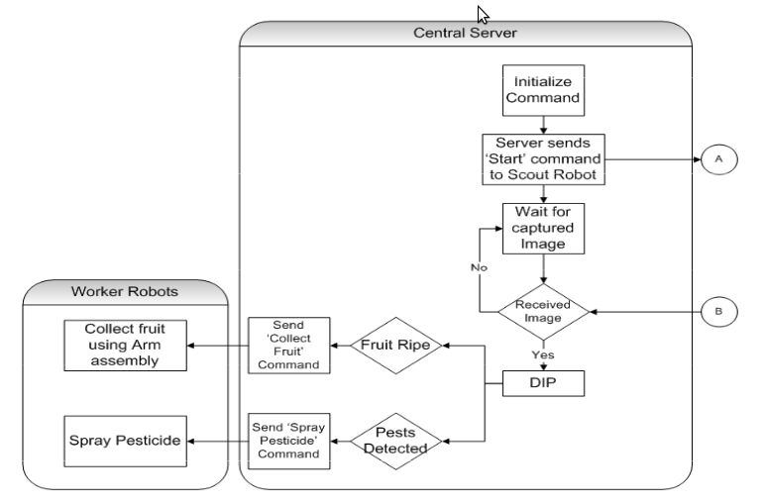
SYSTEM FLOW CHART

Slide 8
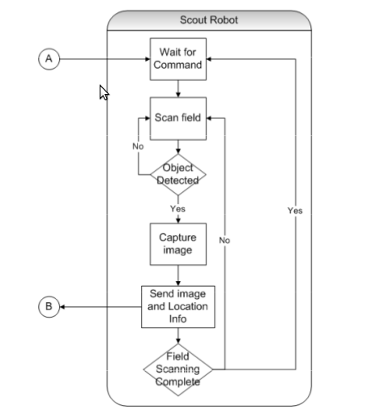
SYSTEM FLOW CHART CONT…

Slide 9
VIDEO

Slide 10
CHALLENGES
Unpredictable behavior of arm assembly
  Soln: The fine tuning of delay between arm assembly commands
Unbalanced wheel motion
  Soln: Rotation based on whiteline sensing
Zigbee interference
  Soln: define proper semantic for the zigbee packet

Slide 11
TASK COMPLETED
 |  | Complete | Incomplete
Central Server | Receive info | Yes
 | DIP | Yes
 | Commands | Yes
Scout Robot | Movement | Yes
 | Loc. identification | Yes
 | Sync operations | Yes
Worker Robot | Goto location | Yes
 | Collect obj | Yes
 | Sync operations | Yes

Slide 12
TEST PLAN
Putting markers with different distances in between
Objects with different colors and intensity
Different heights and distances for objects

Slide 13
PERFORMANCE METRICS
Location identification ability
Object identification ability
Object collection ability

Slide 14
RE-USABILITY FEATURES
Modular coding
Clear interface for various modules
Each module can be independently developed, debugged and tested
Standard naming conventions followed
Code is commented properly
Complete documentation is provided

Slide 15
FUTURE ENHANCEMENTS
Can be prototyped for other functions such as pesticide control, watering etc.
Can be prototyped for intrusion detection in security operations.

